Slide 1
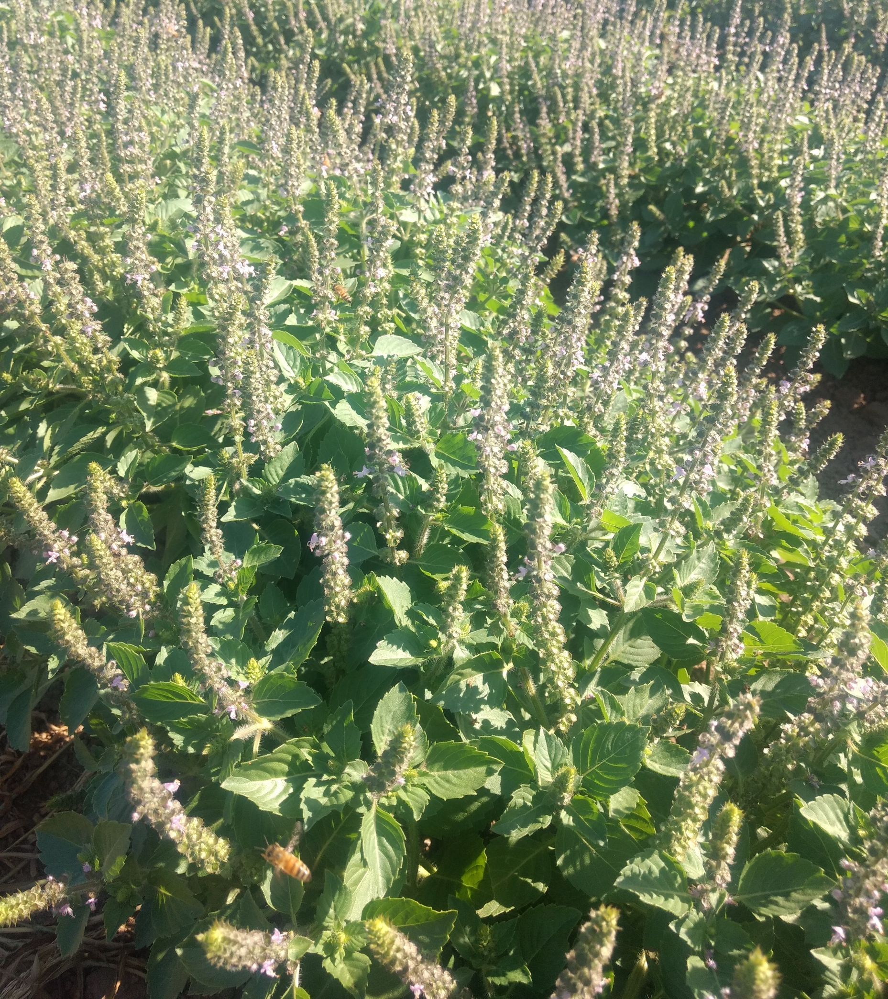
Crop Profile: Tulsi
Ocimum spp.
Family: Lamiaceae
Part used: leaves
Life history: tender annual
Transplant time: 6 weeks
Spacing: 7 - 14” in row, 30” between row
Harvest date: June – October, multiple cuttings
Yield per acre: 2,200 - 2,600 lbs dry weight
Price per lb: $16-30, dried crop

Slide 2
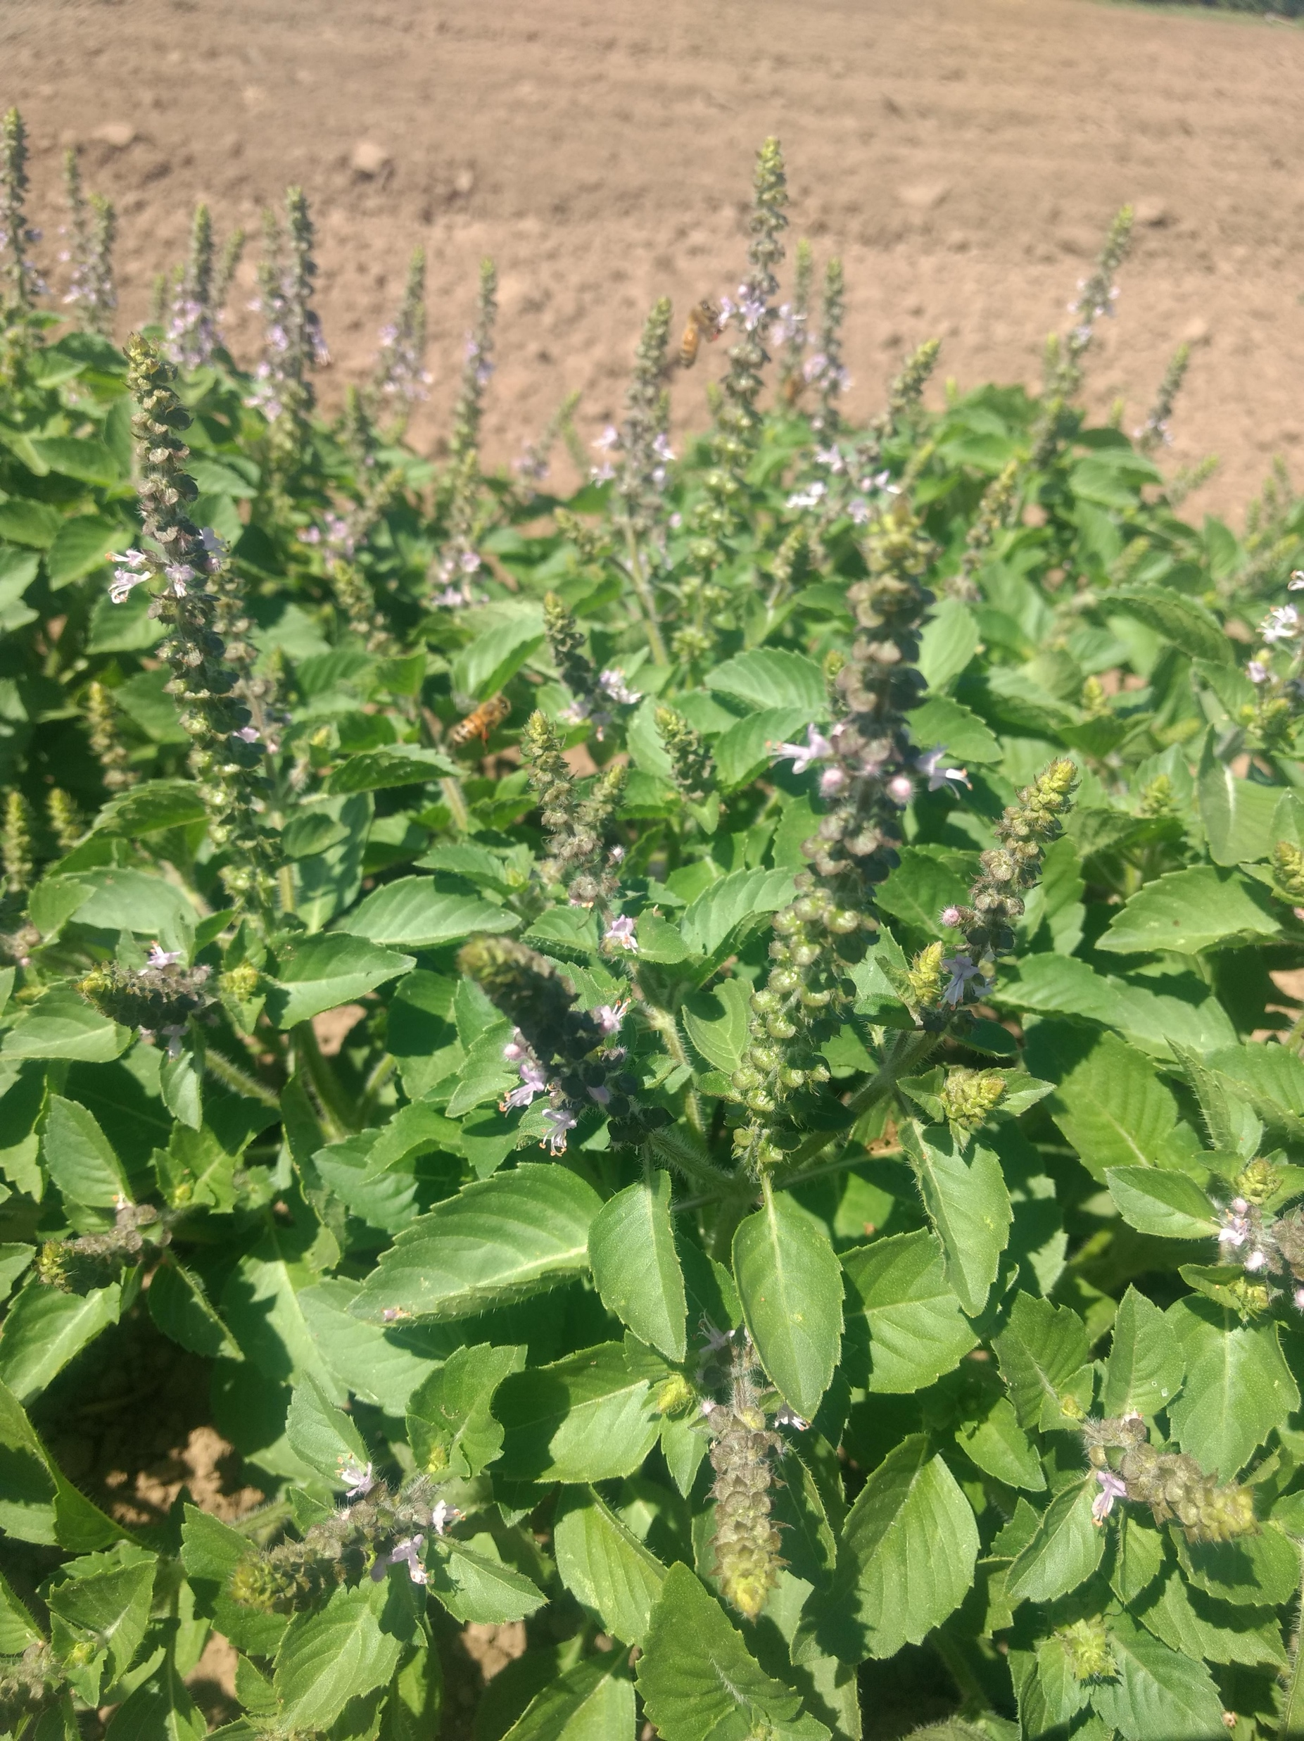
Tulsi: Special Considerations
Some growers report transplant shock- can be hard to establish in field. Pinching helps.
Need to optimize size/timing of transplants if you intend to harvest multiple cuttings per season.
There are multiple species of tulsi!!!

Slide 3
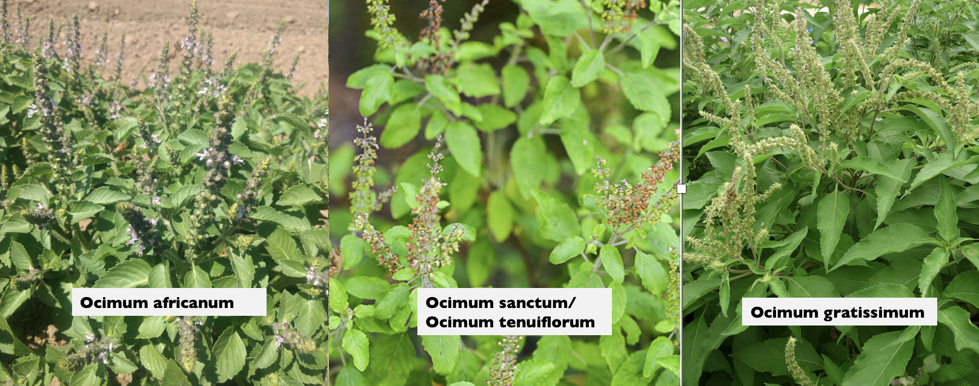
Tulsi 'Temperate' | Ocimum africanum
Tulsi 'Krishna' | Ocimum tenuiflorum
Tulsi 'Rama' | Ocimum tenuiflorum
Tulsi 'Vana' | Ocimum gratissimum

Slide 4
Tulsi
Ocimum spp.
Farm | Density | Spacing | Harvest Timing | Harvest note | Expected Yield
A | 19,000 plants/acre | 28” between rows, 12” in-row spacing | 1st cutting ~July 4th and then every 3-4 weeks later thru early Oct |  | 2,600 lbs dried/acre
B | 30,000 plants/acre | 30” between rows, 7” in-row spacing | Single cutting mid-late Sep |  | 2,220 lbs dried/acre
C ¹ |  | 12" between plants | When it starts to bloom; up to 3 times per season | Hand harvest just above where branching starts. Subsequent harvests- above previous cuts. | 1 lb fresh per plant per season. drying ratio 10:1
D ² |  | 28” between rows, 12” in-row spacing | At flowering but before seed; harvest entire aerial part of the plant with multiple cuttings (3-4) | Harvest at flowering but before seed. Harvest whole plant, leaving 6"-8" to regenerate | 2,400 lb/acre dry with multiple cuttings (4:1 drying ratio)
Lamiaceae family
Tender annual
Species discussion (next slide)
Long germination time
Sow indoors; transplant at 6+ weeks
Harvest when cool, process immediately
Post-harvest drying 100-110º F
Retail prices $16-30 lb dry
C ¹ Chinese Medicinal Herb, P. Schafer
D ² The Organic Medicinal Herb Farmer, J. Carpenter and M. Carpenter

Slide 5
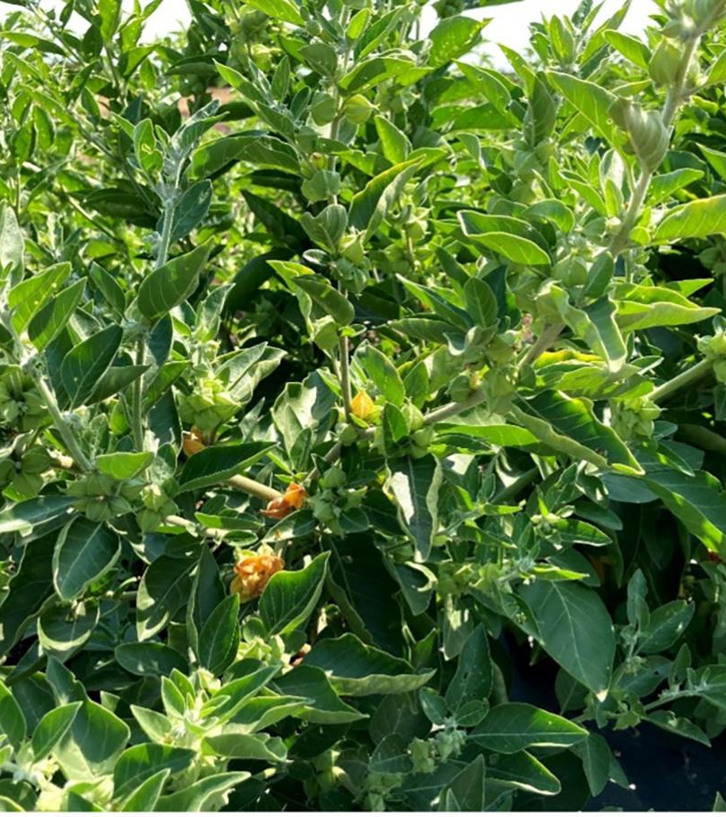
Crop Profile: Ashwagandha
Withania somnifera
Family: Solanaceae
Part used: root
Life history: tender perennial (annual in OR)
Transplant time: 10 – 12 weeks
Spacing: 7 -14” in row, 30” between row
Harvest date: October, after frost
Yield per acre: 1000 – 1800 lbs dry weight
Price per lb: $12-24, dried crop

Slide 6
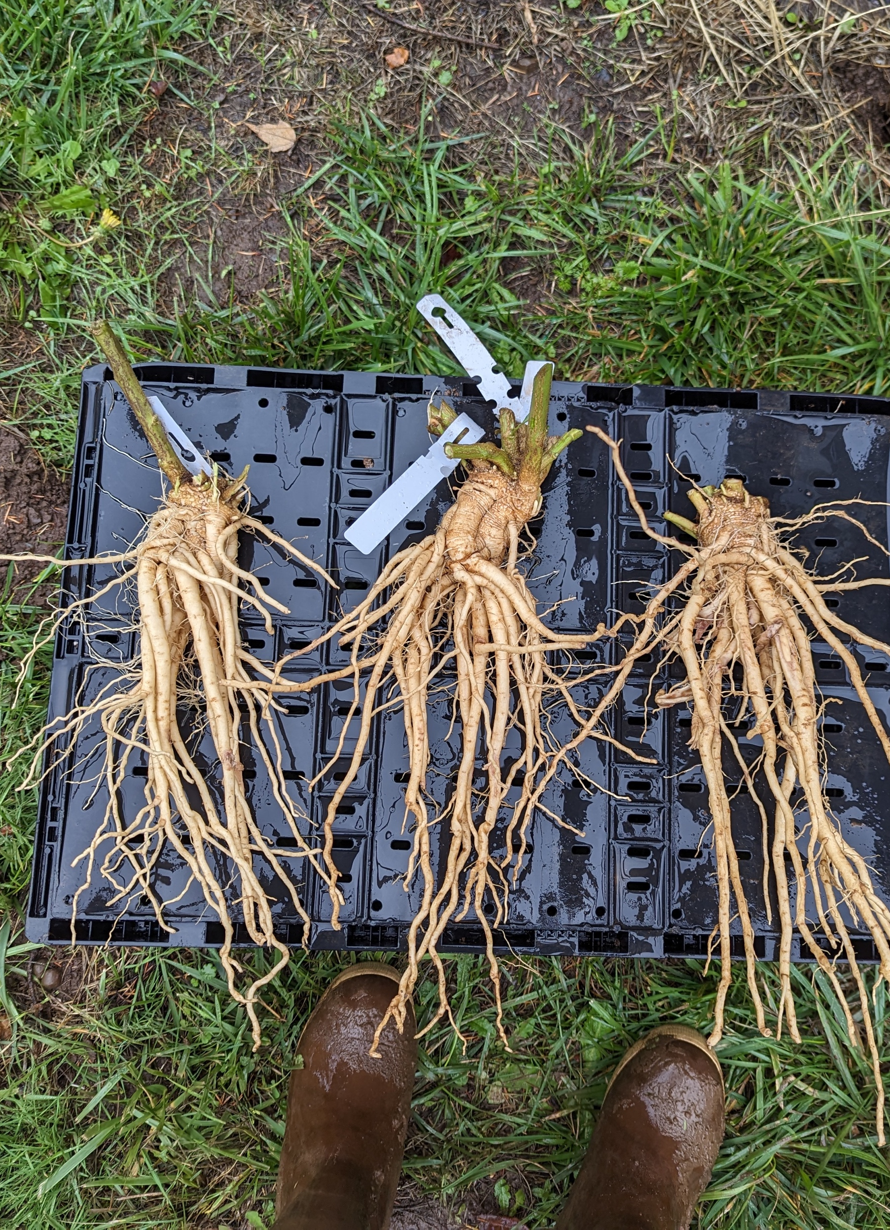

Ashwagandha: Special Considerations
Light dependent germinator; germination can be erratic
Prefers long days and warm nights
Roots can be up to 3 ft long. Raised beds improve drainage and ease of harvest.

Slide 7
Ashwagandha
Withania somnifera
Farm | Density | Spacing | Harvest Timing | Expected Yield
A | 19,000 plants per acre | 28” between rows, 12” in-row spacing | Early October | 1800 lbs dried root/acre
B | 30,000 plants per acre | 30” between rows, 7” in-row spacing | Mid-late Oct | 2021- 720 lbs dried root/acre (abnormal year)
C ¹ |  | 24" between plants |  | 0.5 lb fresh per plant per season (irrigated crops) 3:1 drying ratio
D ² |  | 28" between rows, 12" in row spacing | After first frost | 1000 lbs/acre dried root
Solanaceae family
Light dependent germinator
Sow indoors; 10 weeks to transplant
Long days and warm nights
Post-harvest drying 100-110º F
Retail price $12-24 per lb dry root
C ¹ Chinese Medicinal Herb, P. Schafer
D ² The Organic Medicinal Herb Farmer, J. Carpenter and M. Carpenter

Slide 8
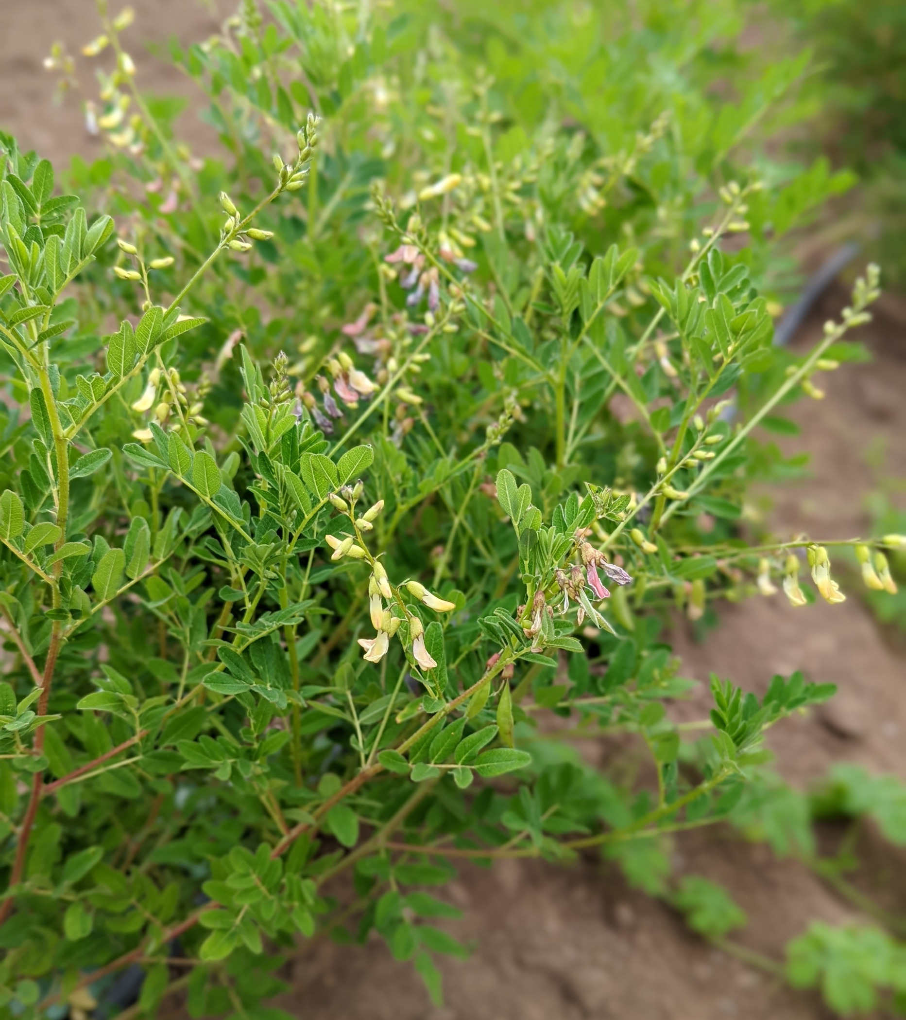
Crop Profile: Astragalus
Astragulus membranaceus
huáng qí
Family: Fabaceae
Part used: root
Life history: hardy perennial
Transplant time: 8 – 12 weeks
Spacing: 12 - 24” in row, 30” between row
Harvest date: Late fall
Yield per acre: 800 lbs dry weight
Price per lb: $16-24, dried crop

Slide 9
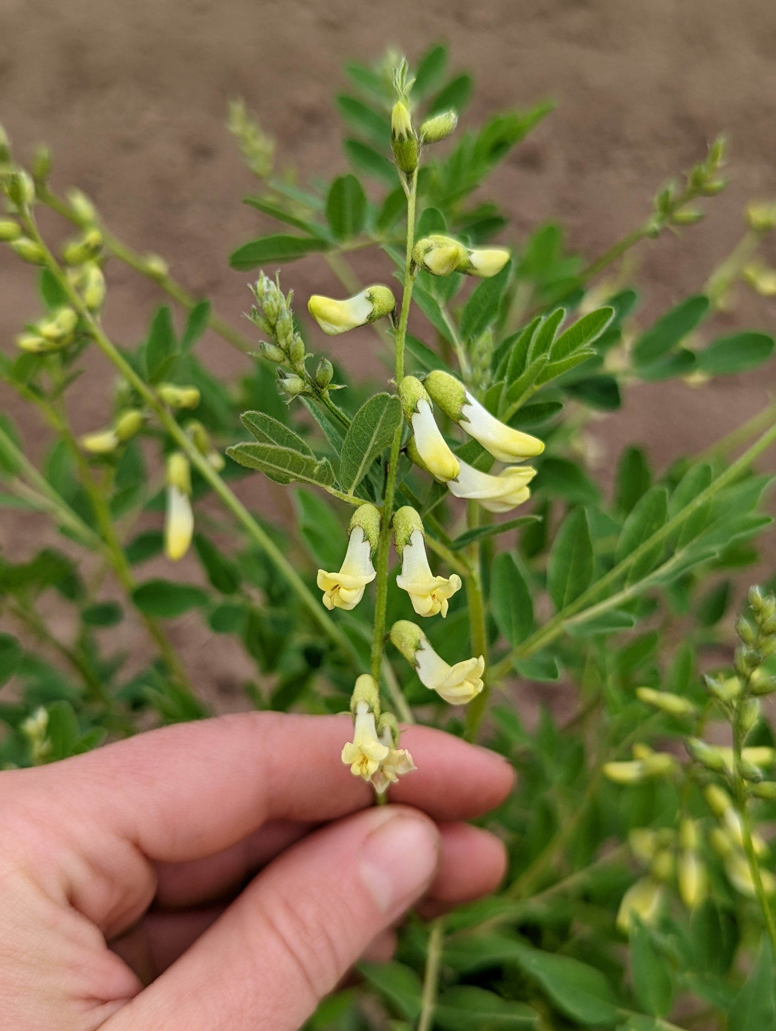
Astragalus: Special Considerations
Harvest is recommended after 3 - 4 years
Oregon growers report up to 25% stand loss over winter, so they limit production to one over-wintering cycle only.
Sensitive to over-watering or standing water in winter.
Prone to soil-borne fungal diseases.

Slide 10
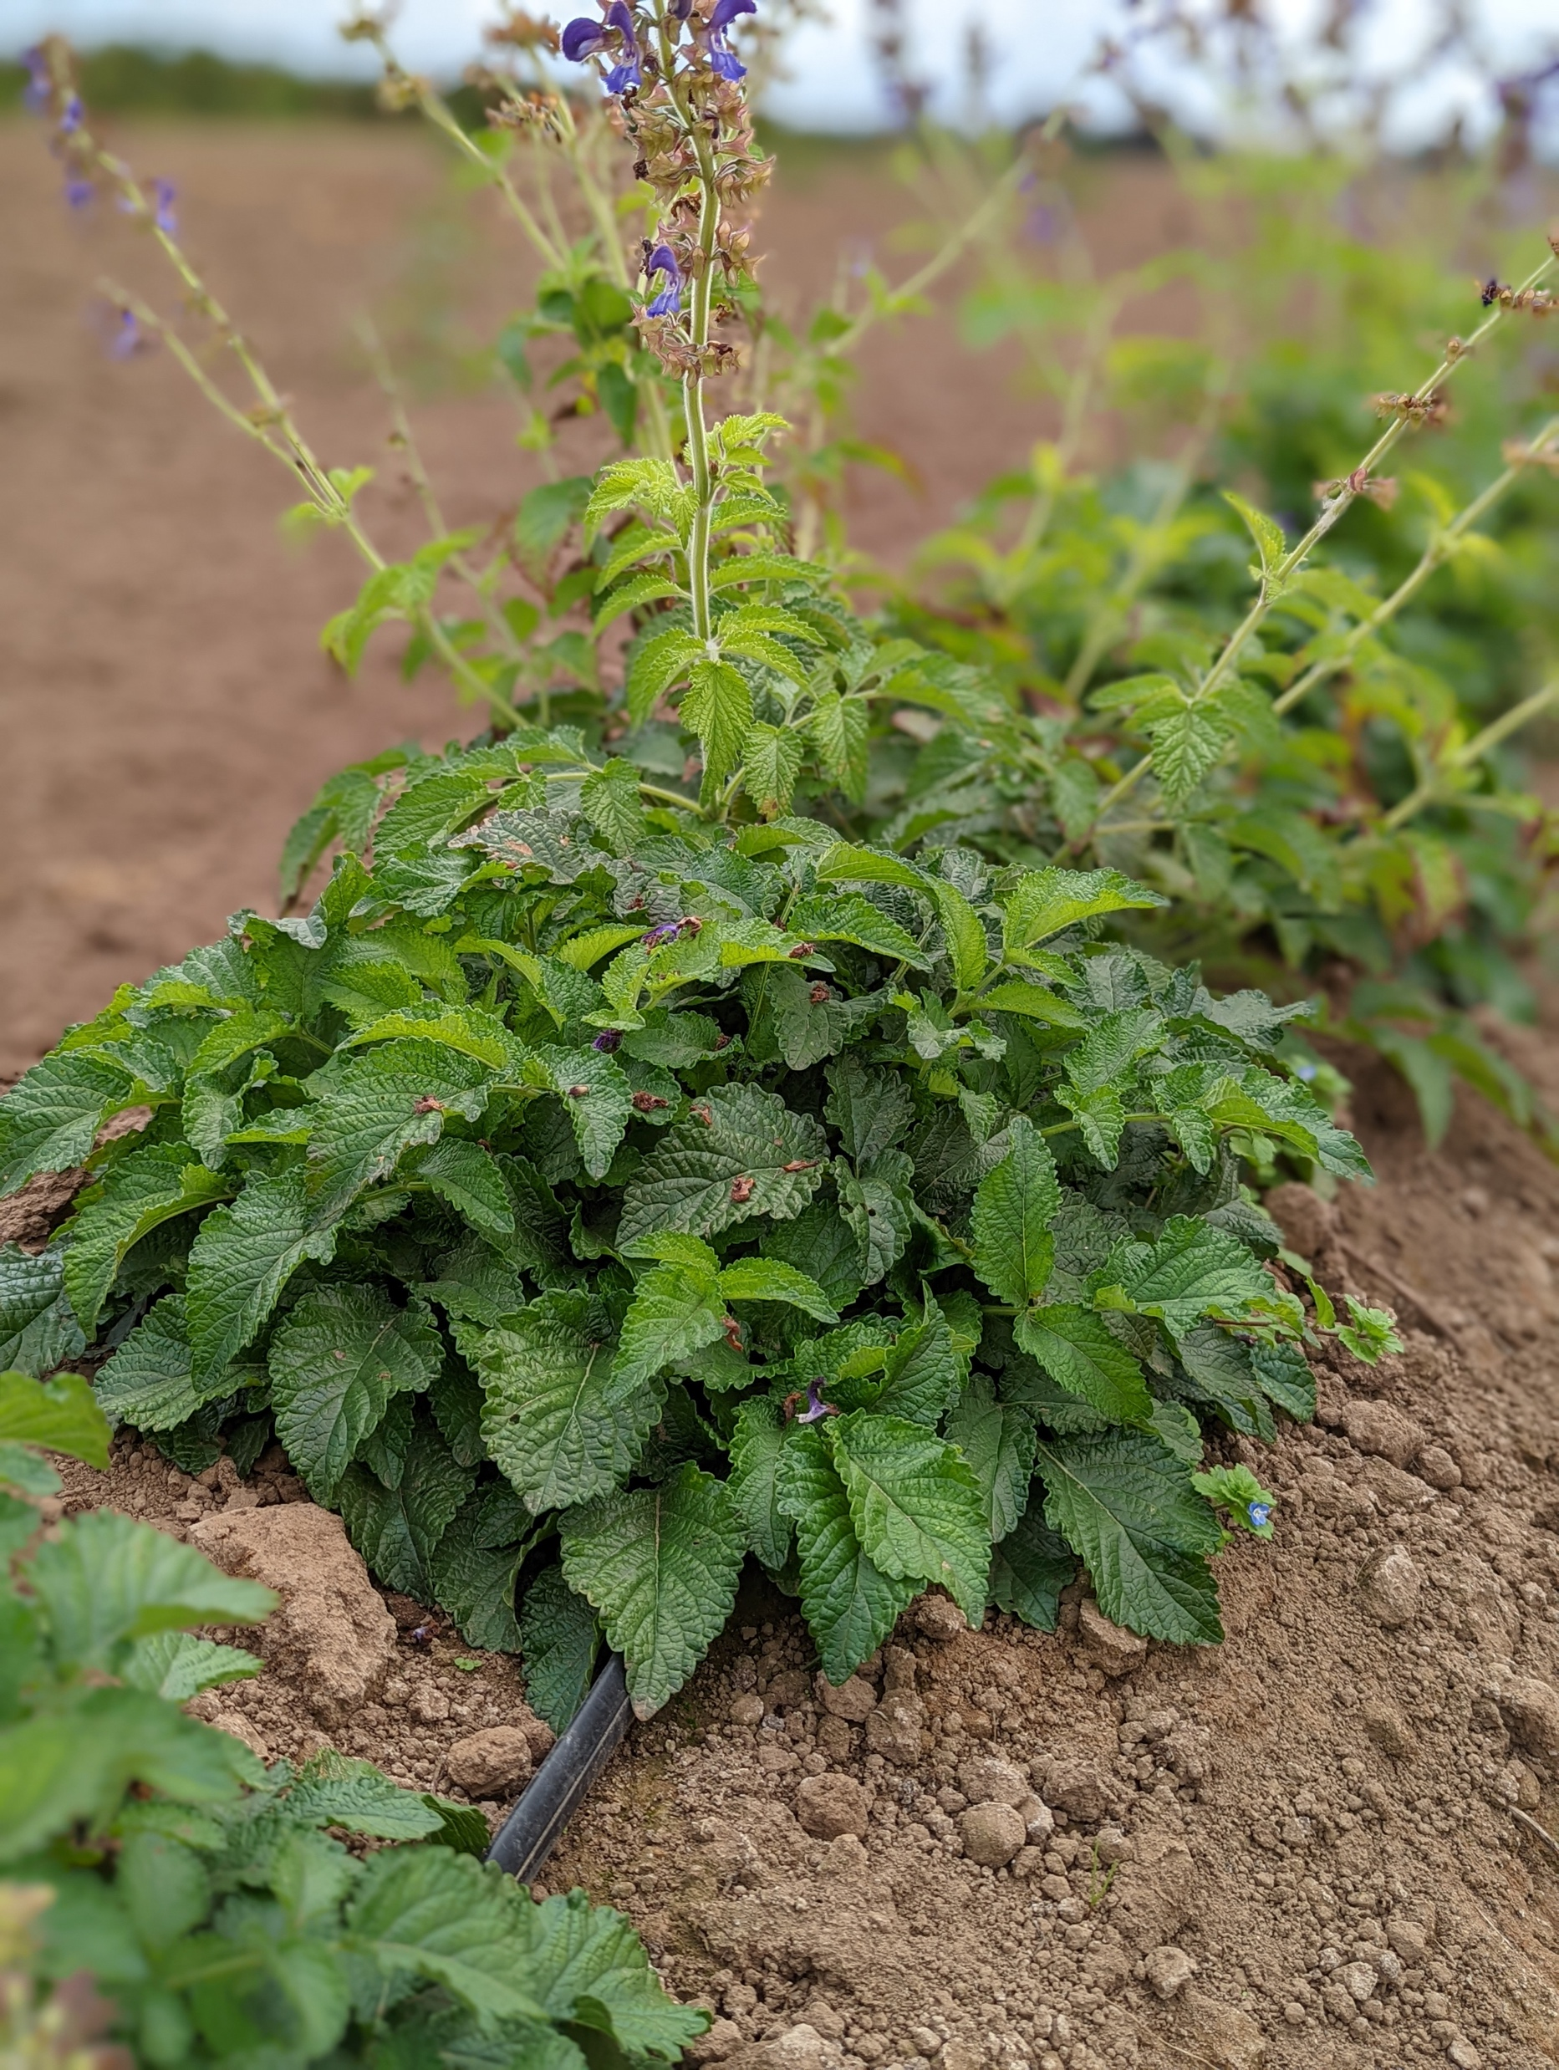
Crop Profile: Red Sage
Salvia miltiorrhiza
dān shēn
Family: Lamiaceae
Part used: root
Life history: hardy herbaceous perennial
Transplant time: 8 – 12 weeks
Spacing: 12 - 24” in row, 12”- 30” between row
Harvest date: Late fall/winter
Yield per acre: 2,500 lbs dry weight
Price per lb: $17 -36, dried crop

Slide 11
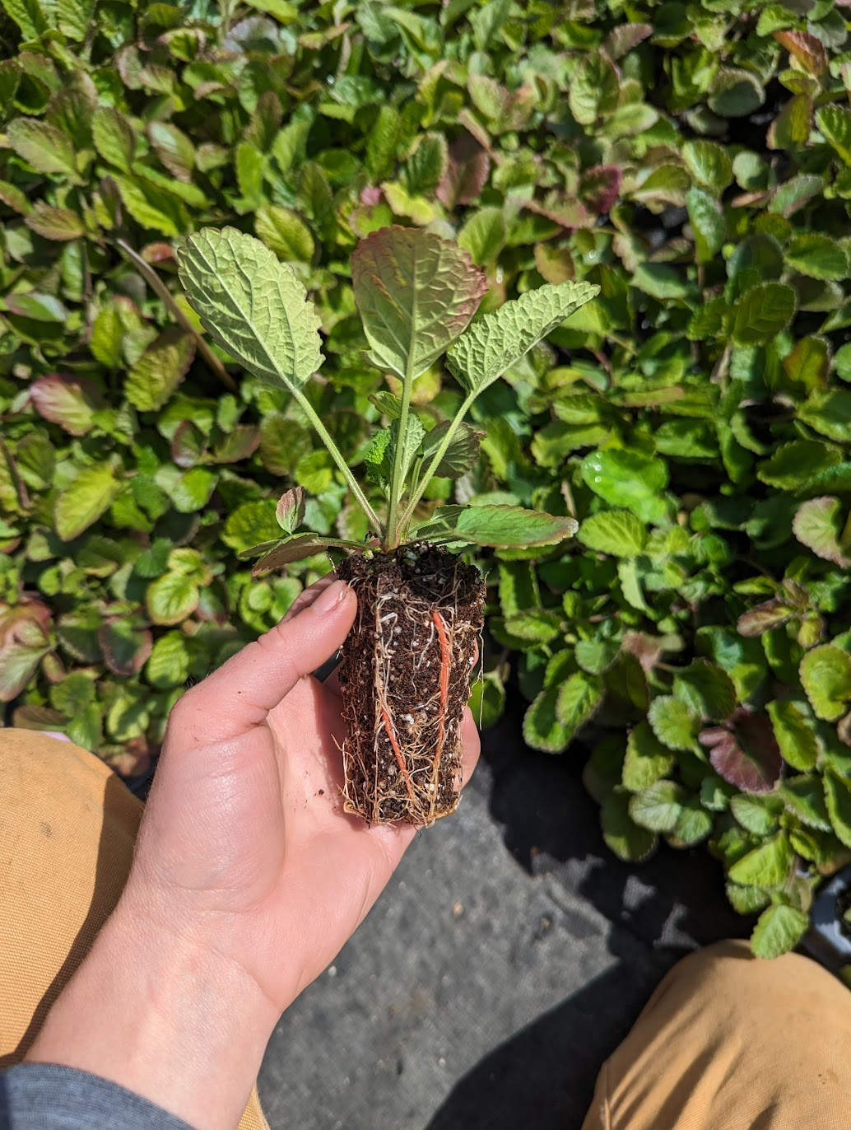
Red Sage: Special Considerations
Bottom heat aids in germination. Prefers a deeper cell. Pots up well.
Should be planted in spring and harvested in fall/winter of 2nd or 3rd year for roots of adequate size.
Needs to be harvested when plant is dormant and air temp is 20-25 °F – timing likely to be late in fall/winter in our area, when fields are wet.

Slide 12
Red Sage
Salvia miltiorrhiza
Farm | Density | Spacing | Harvest Timing | Harvest Stages | Post-Harvest | Expected Yield
A
B
C ¹ |  | 12"-24" between row and in row | one year or older roots, late fall and early spring | winter dormant | remove crown and small rootlets, power wash, slice into 1/4" slices and dry | 0.25-0.5 lbs fresh per 2-year old roots; drying ratio 4:1
D ²
Lamiaceae family
Hardy perennial (zones 6-9)
Sow indoors; transplant at 10 weeks
10-21 days to germ indoors (bottom heat helps)—consider deeper flats
Post-harvest handling—washing, slicing, drying
Prices???
C ¹ Chinese Medicinal Herb, P. Schafer
D ² The Organic Medicinal Herb Farmer, J. Carpenter and M. Carpenter

Slide 13
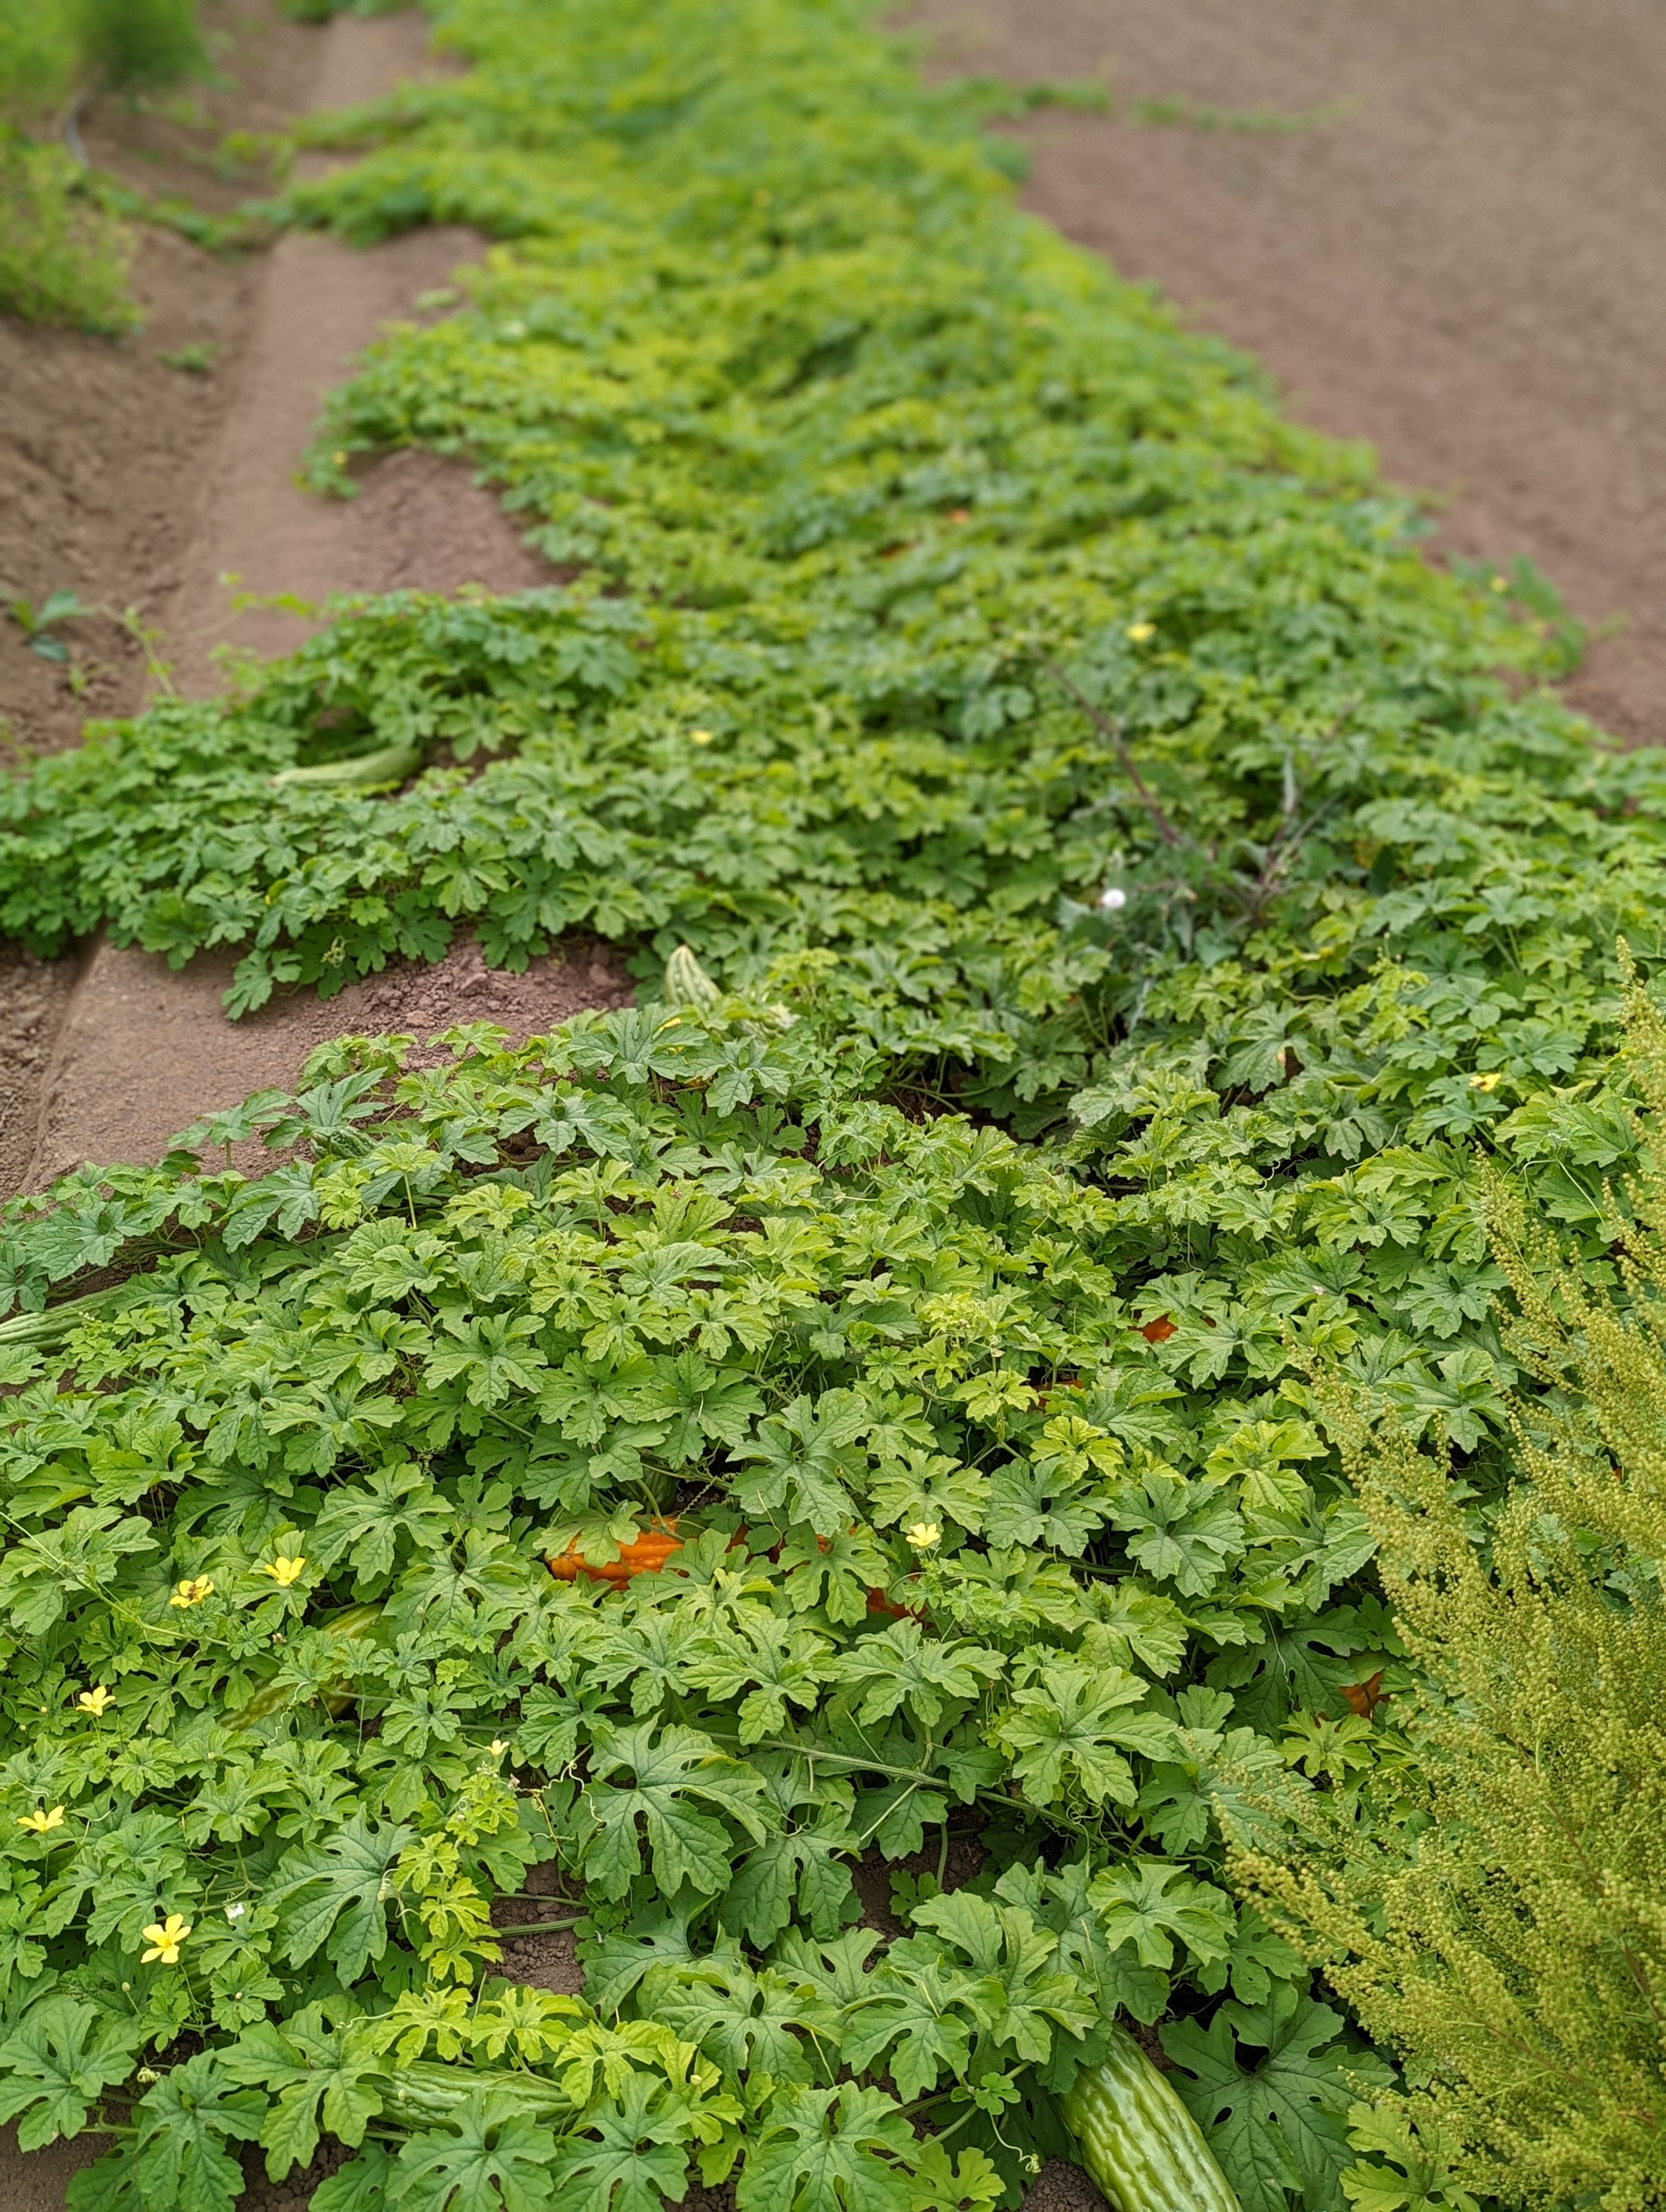
Crop Profile: Bitter Melon
Momordica charantia
kǔ guā
Family: Cucurbitaceae
Part used: fruit
Life history: tender annual
Transplant time: 4 weeks, or direct seed
Spacing: 24” in row, 30” between row
Harvest date: late summer until frost
Yield per acre: unknown
Price per lb: unknown

Slide 14
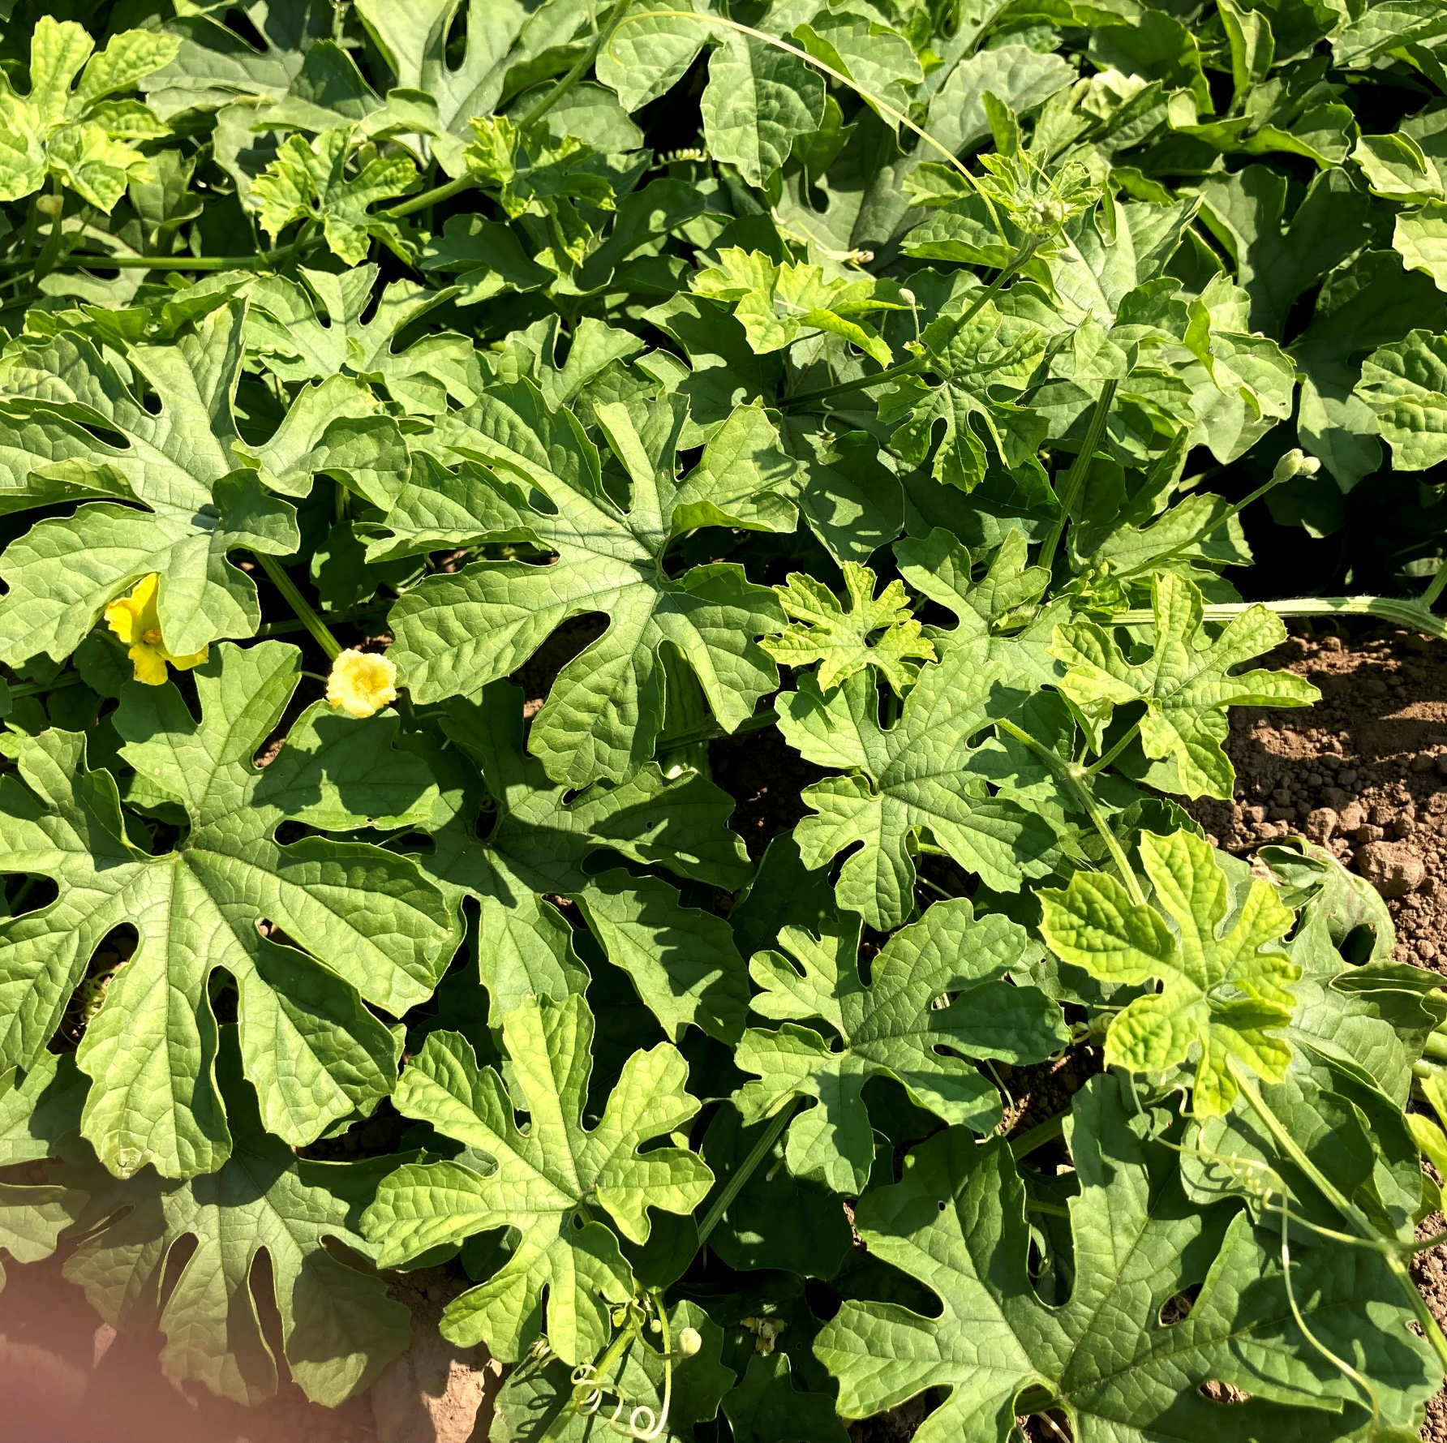
Bitter Melon: Special Considerations
Soaking seed overnight and bottom heat aids in germination.
Susceptible to same problems as other cucurbits, including mildews and cucumber beetles.
Trellis for ease of harvest.
Culinary and medicinal.

